Slide 1
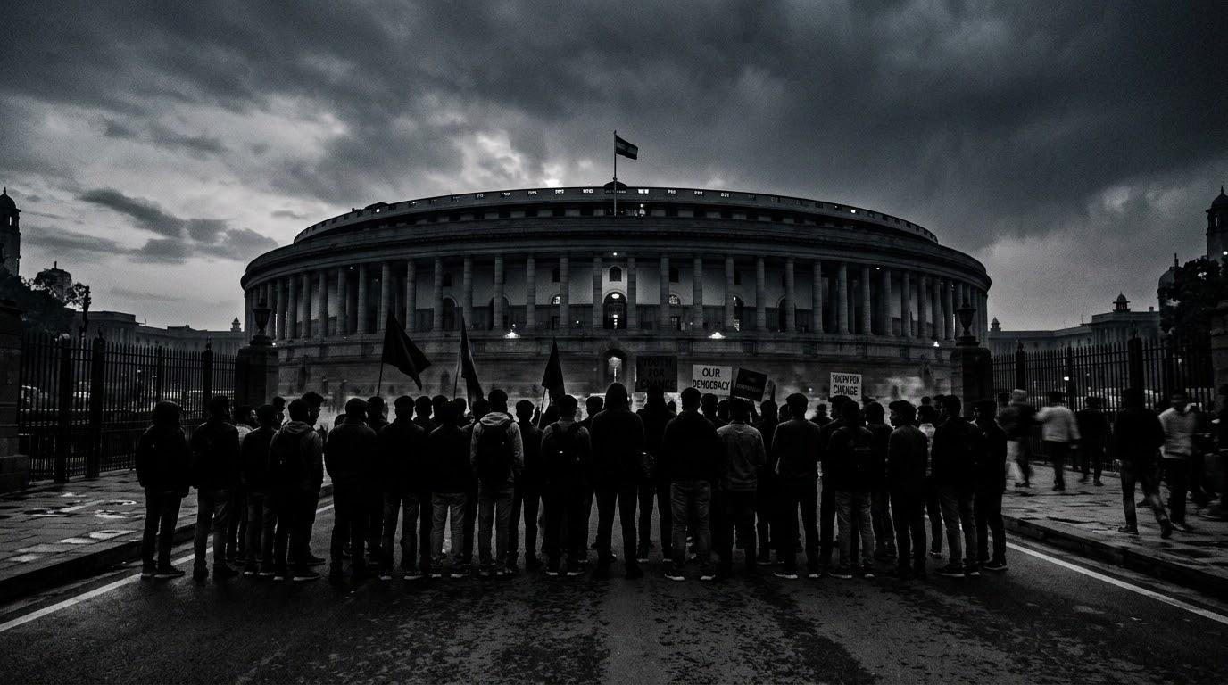


POLITICS IN INDIA:
ARE WE DEBATING WHAT MATTERS?
YASH VARDHAN SINGH | 2025442587

Slide 2
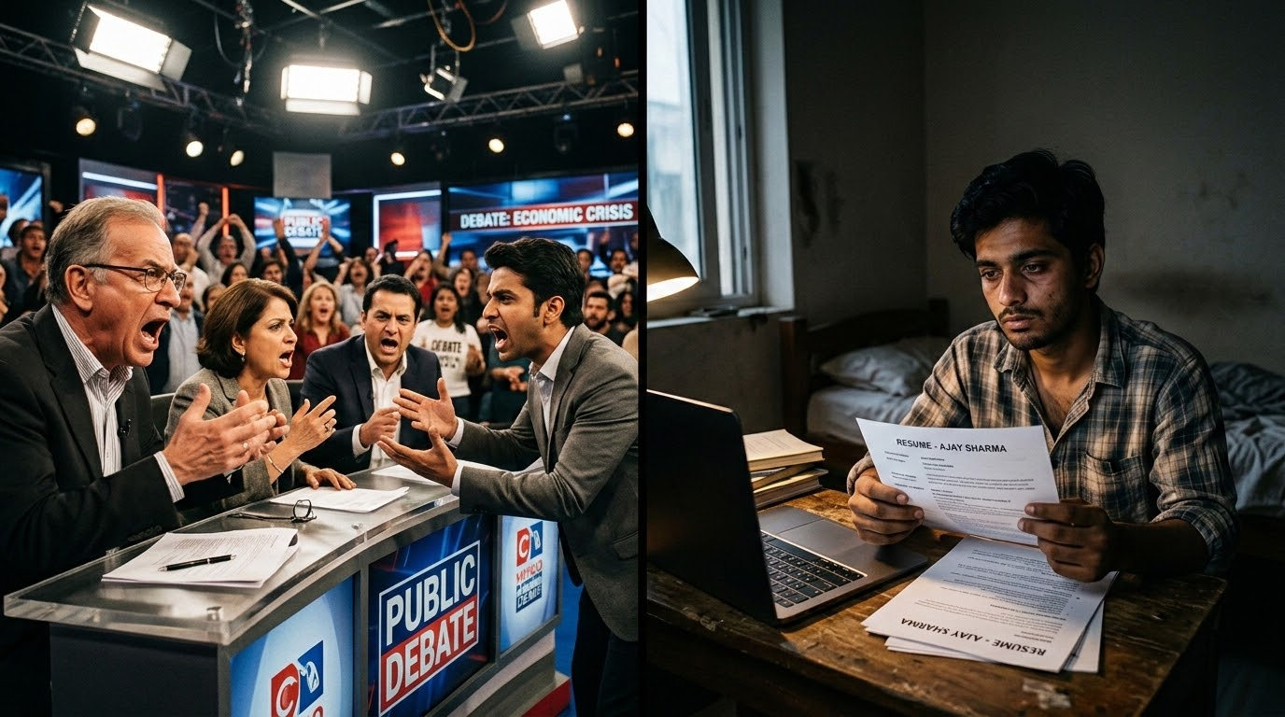
"
When politics becomes a battle of identities...
what happens to our future?
Modern political debates frequently prioritize emotional and ideological clashes over actionable policy.
This constant distraction leaves critical, future-oriented discussions sidelined, directly impacting the trajectory of our nation's development and the prospects of its younger generations.

Slide 3
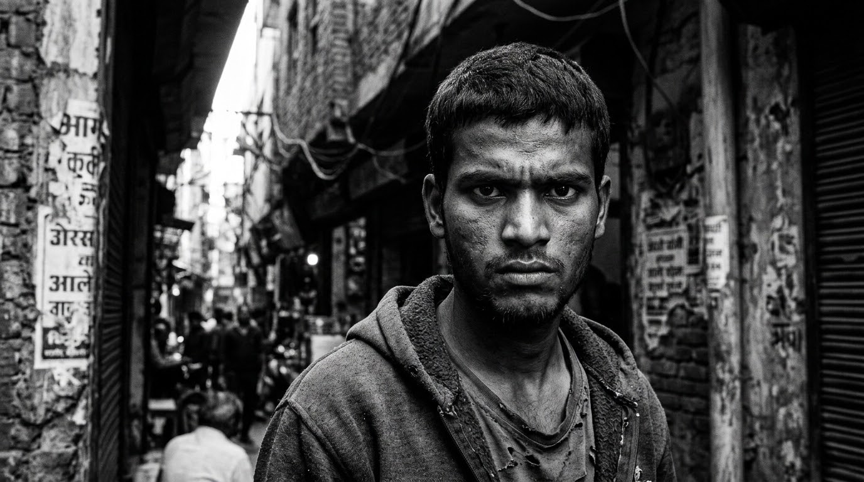


DOCUMENTARY PERSPECTIVE // YOUTH OF INDIA
WE DON'T NEED SPEECHES.
WE NEED OPPORTUNITIES.
India boasts one of the world's largest youth populations, representing a massive silent majority. This demographic requires concrete economic pathways, robust skill development, and genuine employment prospects. Empty political rhetoric fails to address the urgent reality of securing a stable and prosperous future.

Slide 4
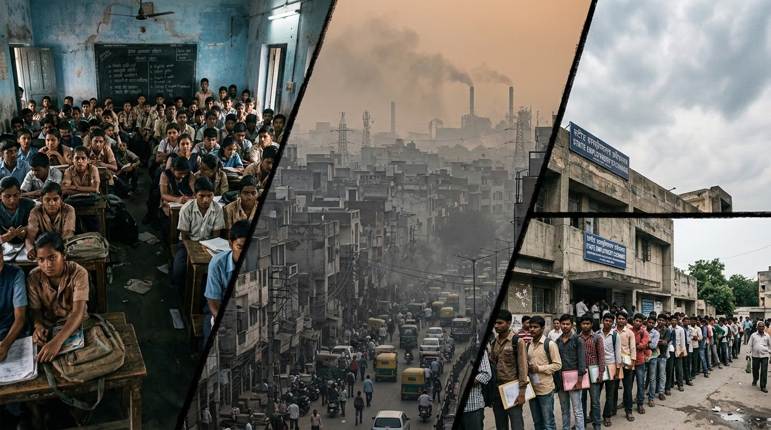
The loudest noise gets the attention.
The deepest problems get ignored.
Mainstream political discourse often suffers from a severe attention deficit regarding core developmental issues. Critical pillars of society are frequently overshadowed by sensationalism, leaving urgent systemic challenges unaddressed.
We must refocus the conversation on:
• Job Creation
• Educational Reform
• Environmental Sustainability
DOCUMENTARY EVIDENCE // CRITICAL SYSTEMIC PILLARS

Slide 5






If YOU were the leader of India for one day...
WHAT WOULD YOU TALK ABOUT FIRST?
Shifting the political narrative requires active participation and a fundamental re-evaluation of our priorities. This is a moment to reflect on the most pressing issues that directly impact our communities and demand focus from our leadership.

Slide 6
THE QUESTION IS NOT: WHO WILL LEAD INDIA?
THE QUESTION IS: WHAT KIND OF INDIA WILL WE DEMAND?
True democratic progress relies on an informed and demanding electorate. We must shift our focus from individual personalities to systemic accountability and actionable change.
THANK YOU.

